Slide 1
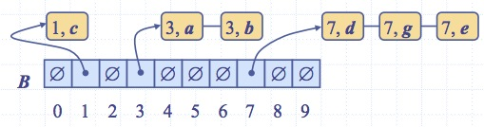
Lesson 7
Sorting in Linear Time
: Discovering the Range of Natural Law
Wholeness of the Lesson
Using the technique of decision trees, one establishes the following lower bound on comparison-based sorting algorithms: Every comparison-based sorting algorithm has at least one worst case for which running time is Ω(n log n). Bucket Sort and its relatives, under suitable conditions, run in linear time in the worst case, but are not comparison-based algorithms. Each level of existence has its own laws of nature. The laws of nature that operate at one level of existence may not apply to other levels of existence.
Notes:
Radish-Sort

Slide 2
Sorting So Far
Insertion sort:
  Easy to code
  Fast on small inputs (less than ~50 elements)
  Fast on nearly-sorted inputs
  O(n²) worst case
  O(n²) average (equally-likely inputs) case
  O(n²) reverse-sorted case

Slide 3
Sorting So Far
Merge sort:
  Divide-and-conquer:
    Split array in half
    Recursively sort subarrays
    Linear-time merge step
  O(n lg n) worst case
  Doesn’t sort in place

Slide 4
Sorting So Far
Heap sort (will cover later):
  Uses the very useful heap data structure
    Complete binary tree
    Heap property: parent key > children’s keys
  O(n lg n) worst case
  Sorts in place
  Fair amount of shuffling memory around

Slide 5
Sorting So Far
Quick sort:
  Divide-and-conquer:
    Partition array into two subarrays, recursively sort
    All of first subarray < all of second subarray
    No merge step needed!
  O(n lg n) average case
  Fast in practice (2-3 times faster than Merge sort)
  O(n²) worst case – but probability of this case is very low (randomization)

Slide 6
How Fast Can We Sort?
We will provide a lower bound, then beat it
  How do you suppose we’ll beat it?
First, an observation: all of the sorting algorithms so far are comparison sorts
  The only operation used to gain ordering information about a sequence is the pairwise comparison of two elements
  Theorem: all comparison sorts are Ω(n lg n)
    Note - A comparison sort must do O(n) comparisons

Slide 7
Decision Trees
Decision trees provide an abstraction of comparison sorts
  A decision tree represents the comparisons made by a comparison sort. Every thing else ignored
  >> Diagram in NEXT PAGE
What do the leaves represent?
How many leaves must there be?

Slide 8
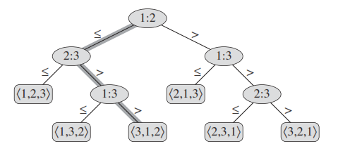
Decision Trees

Slide 9
Anatomy of the Decision Tree
Each node of the tree represents all possible sorting outcomes that have not been eliminated by the comparisons done so far.
The labels on the links of the tree represent comparison steps as the algorithm runs. Different algorithms will perform some of the comparison steps in a different sequence.
A leaf in the decision tree represents a possible sorting outcome. The different paths to the leaves represent all possible ways three (in this case) distinct items could be put in sorted order; therefore, the leaves represent all possible arrangements of 3 distinct elements.

Slide 10
Strategy for Computing # Comparisons
Observation: The number of comparisons performed in order to arrive at an arrangement found in a leaf node equals the depth of that leaf node in the decision tree.
Therefore, to count # comparisons performed in the worst case, we determine the depth of the deepest node in the decision tree

Slide 11
A Lower Bound on Comparison-Based Sorting Algorithms
All sorting algorithms discussed so far have used comparison as a central operation
So far, all sorting algorithms discussed have a worst-case running time of Ω(nlog n) [we are excluding O(n^2) Insertion, Bubble and Selection sort; these are good for small size array]
Using the technique of decision trees we can show that nlog n is the best that can be done for comparison-based sorting algorithms

Slide 12
Lower Bound For
Comparison Sorting
Theorem: Any decision tree that sorts n elements has height Ω(n lg n) [as mentioned]
What’s the minimum # of leaves?
What’s the maximum # of leaves of a binary tree of height h?
Clearly the minimum # of leaves is less than or equal to the maximum # of leaves

Slide 13
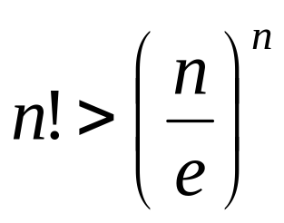
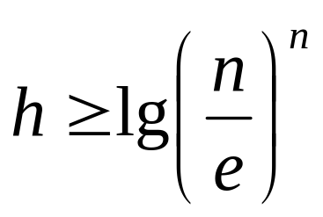
Lower Bound For
Comparison Sorting
We know there are n! leaves. We also know that a tree with height h has max 2^{h} leaves. So we have…
n! ≤ 2^{h}
Taking logarithms:
lg (n!) ≤ h
Stirling’s approximation tells us:
Thus:

Slide 14
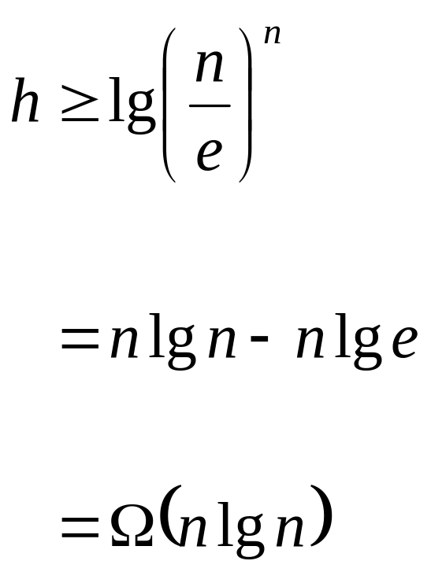
Lower Bound For
Comparison Sorting
So we have
Thus the minimum height of a decision tree is Ω(n lg n)

Slide 15
Sorting In Linear Time
But the name of this lecture is “Sorting in linear time”!
  How can we do better than Ω(n lg n)?

Slide 16
Sorting In Linear Time
Counting sort
  No comparisons between elements!
  But…depends on assumption about the numbers being sorted
    We assume numbers are in the range 1.. k
  The algorithm:
    Input: A[1..n], where A[j] ∈ {1, 2, 3, …, k}
    Output: B[1..n], sorted (notice: not sorting in place)
    Also: Array C[1..k] for auxiliary storage

Slide 17
Counting Sort
1 CountingSort(A, B, k)
2 for i=1 to k
3 C[i]= 0;
4 for j=1 to n
5 C[A[j]] += 1;
6 for i=1 to k
7 C[i] = C[i] + C[i-1];
8 for j=n down to 1
9 B[C[A[j]]] = A[j];
10 C[A[j]] -= 1;

Slide 18
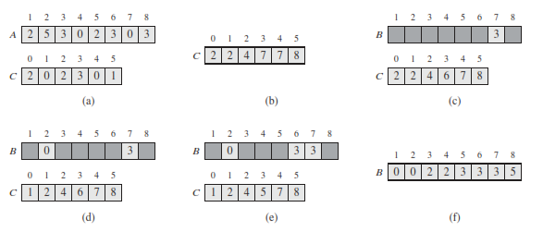
Counting Sort - Example
1

Slide 19
Counting Sort
1 CountingSort(A, B, k)
2 for i=1 to k
3 C[i]= 0;
4 for j=1 to n
5 C[A[j]] += 1;
6 for i=1 to k
7 C[i] = C[i] + C[i-1];
8 for j=n downto 1
9 B[C[A[j]]] = A[j];
10 C[A[j]] -= 1;
Takes time O(k)
Takes time O(n)
What will be the running time?

Slide 20
Counting Sort
Total time: O(n + k)
  Usually, k = O(n)
  Thus counting sort runs in O(n) time
But sorting is Ω(n lg n)!
  No contradiction--this is not a comparison sort (in fact, there are no comparisons at all!)
  Notice that this algorithm is stable i.e. preserve order when there is a tie (Decrementing C[i] in Line 10)

Slide 21
Counting Sort
Cool! Why don’t we always use counting sort?
Because it depends on range k of elements
Could we use counting sort to sort 32 bit integers? Why or why not?
Answer: no, k too large (2³² = 4,294,967,296)
[not in place sorting!]

Slide 22
Counting Sort
How did IBM get rich originally?
Answer: punched card readers for census tabulation in early 1900’s.
  In particular, a card sorter that could sort cards into different bins
    Each column can be punched in 12 places
    Decimal digits use 10 places
  Problem: only one column can be sorted on at a time

Slide 23
Radix Sort
Intuitively, you might sort on the most significant digit, then the second msd, etc.
Problem: lots of intermediate piles of cards (read: scratch arrays) to keep track of
Key idea: sort the least significant digit first

Slide 24
Radix Sort
Key idea: sort the least significant digit first
  RadixSort(A, d)
  for i=1 to d
  StableSort(A) on digit i
  Example: Fig 9.3

Slide 25
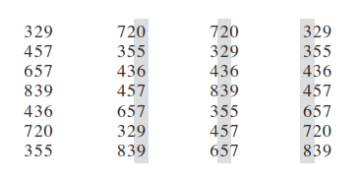
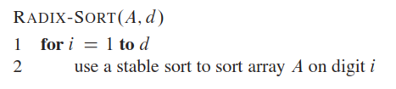
Radix Sort

Slide 26
Radix Sort
What sort will we use to sort on digits?
Counting sort is obvious choice:
  Sort n numbers on digits that range from 1..k
  Time: O(n + k)
Each pass over n numbers with d digits takes time O(n+k), so total time O(dn+dk)
  When d is constant and k=O(n), takes O(n) time

Slide 27
Radix Sort
Problem: sort 1 million 64-bit numbers
  Treat as four-digit radix 2¹⁶ numbers
  Can sort in just four passes with radix sort!
Compares well with typical O(n lg n) comparison sort
  Requires approx lg n = 20 operations per number being sorted
Does it sort in place with Counting Sort?

Slide 28
Radix Sort
In general, radix sort based on counting sort is
  Fast
  Asymptotically fast (i.e., O(n))
  Simple to code
  A good choice

Slide 29
Bucket Sort
Key Idea
  Divide into n equal sized buckets
  Distribute the n input numbers into the buckets
  Then sort the numbers in each bucket
  Example – Next page

Slide 30
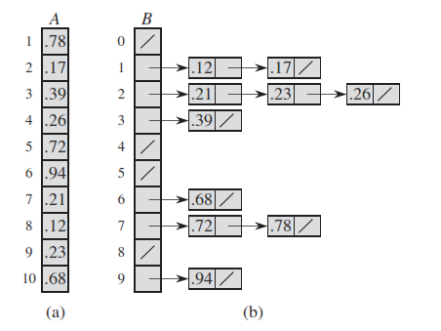
Bucket Sort

Slide 31
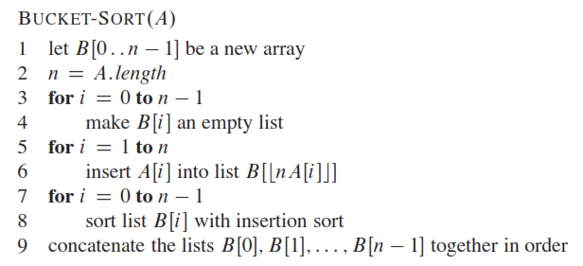
Bucket Sort

Slide 32

Bucket Sort
Running time
(the 2nd term is for the Insertion sort)

Slide 33
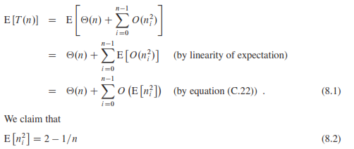
Bucket Sort
Running time – 2nd term
>> Hence Linear

Slide 34
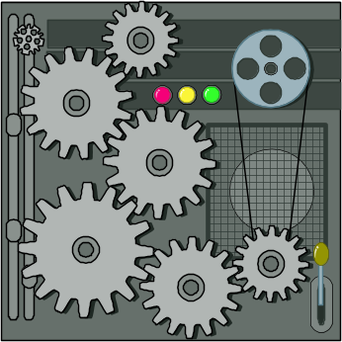
Radix-Sort - Revisited
Radix-sort can be considered as a generalization of BucketSort that uses multiple bucket arrays
  E.g. use of 2 Bucket arrays in Lab 6
Example: Sort 48, 1, 6, 23, 37, 19 ,21
BucketSort doesn’t work because range is too big – would run in
Ω(n²)
Bucket-Sort and Radix-Sort

Slide 35
Radix Sort Example
Strategy is to use 2 bucket arrays, each of size 7 (7 is the radix)
Based on observation that every k in [0,48] can be written:
k = 7q + r where 0 <= q < 7, 0 <= r < 7
Procedure:
  Pass #1: Scan initial array and place values the “remainders” bucket r[] – put x in r[i] if x % 7 = i. (Need to assume bucket array consists of lists)
  Pass #2: Scan r[], reading from front of each list to back, and place values in the “quotients” bucket q[] – put x in q[i] if x/7 = i.
  Output: Scan q[], again reading lists front to back
Bucket-Sort and Radix-Sort

Slide 36
Main Point
A decision-tree argument shows that comparison-based sorting algorithms can perform no better than Θ(nlog n). However, BucketSort is an example of a sorting algorithm that runs in O(n). This is possible only because BucketSort does not rely primarily on comparisons in order to perform sorting. This phenomenon illustrates two points from SCI. First, to solve a problem, often the best approach is to bring a new element to the situation (in this case, bucket arrays); this is the Principle of the Second Element. The second point is that different laws of nature are applicable at different levels of creation. Deeper levels are governed by more comprehensive and unified laws of nature.

Slide 37
Connecting the Parts of Knowledge
With The Wholeness of Knowledge
Transcending The Lower Bound On Comparison-Based Algorithms
1. Comparison-based sorting algorithms can achieve a worst-case running time of Θ(n log n), but can do no better.
2. Under certain conditions on the input, Bucket Sort and Radix Sort can sort in
O(n) steps, even in the worst case. The n log n bound does not apply because these algorithms are not comparison-based.
3. Transcendental Consciousness is the field of all possibilities and of pure orderliness. Contact with this field brings to light new possibilities and leads to spontaneous orderliness in all aspects of life.
4. Impulses Within The Transcendental Field. The organizing power of pure knowledge is the lively expression of the Transcendent, giving rise to all expressions of intelligence.
5. Wholeness Moving Within Itself. In Unity Consciousness, the organizing dynamics at the source of creation are appreciated as an expression of one’s own Self.

